Slide 1

Analyzing Trending YouTube Videos

Slide 2
Introduction
​​ Predictive Analytics Dashboard
YouTube Data API v3
Semi-structured data obtained from the API.
Volume, Velocity, Variety, Value.
Analyzing Trending Videos
Understanding Content, Audience based on location and time.
Learn Advertisement insights.
Performance Tracking.
AWS Technologies
Use Aws services for scalability as per requirements.
Secure Storage and monitoring.

Slide 3




Team 1​
​
Presenters
Ashish Agarwal
RajaReddy Dondeti
Vaishnavi Kukkala
Harikrishna Para
Team Lead & Data Analyst
Data Scientist​
Data Researcher & Engineer​
Data Engineer​

Slide 4
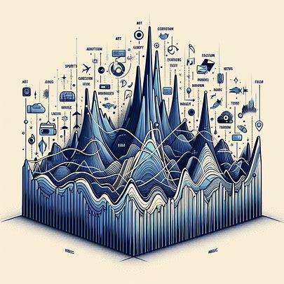
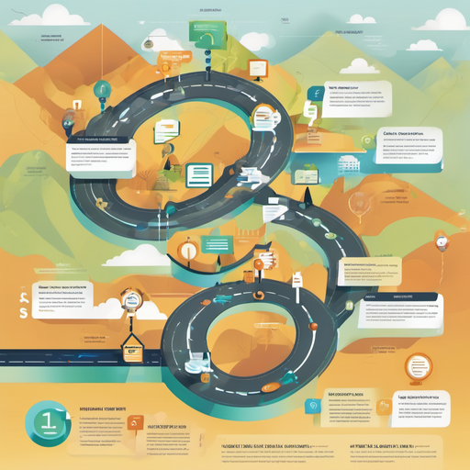

Problem Statement
Hard to keep up with evolving audience interests
Video creators lack insights into optimizing content
Lack of Long-Term Strategy for Content Creators
3

Slide 5
Proposed ﻿Solution
​​ Predictive Analytics Dashboard
Trending Videos Analysis:
identifying current trends in video topics, formats, and content styles.
Informed about what's capturing viewers' attention.
Adapt content to align these trends.
Engagement Patterns:
Learn viewer engagement metrics based on video length, upload frequency, and publishing times.
Understand how audience preferences may be changing.
Maximize engagement and reach a wider audience.

Slide 6
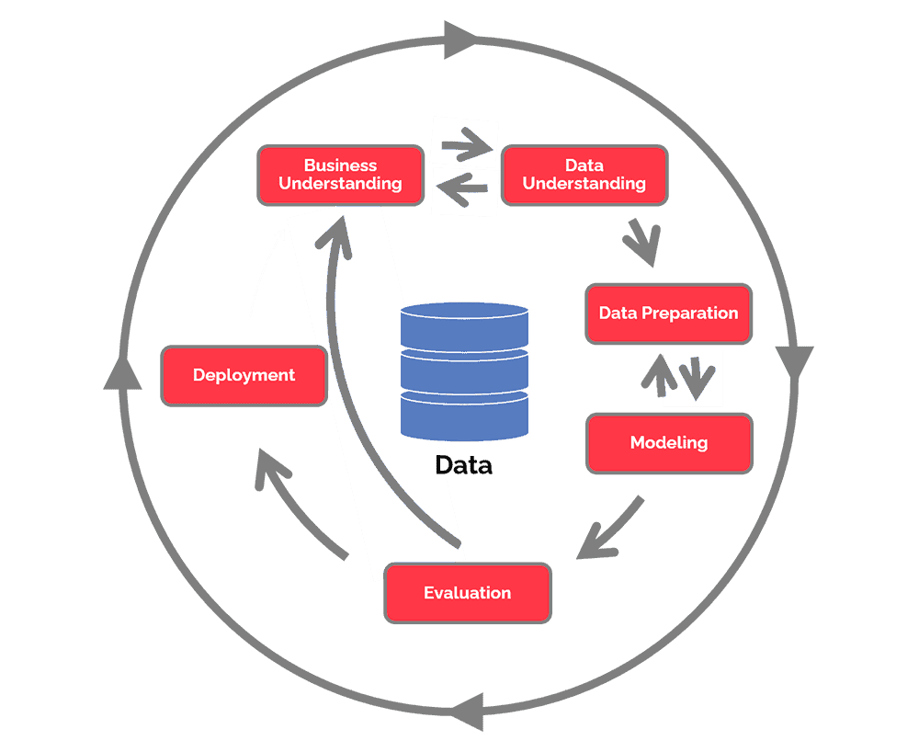
CRISP-DM METHODOLOGY

Slide 7
Project Execution Phases
Data Extraction
Data Transformation
Data Loading
Secure Storage
Monitoring
Data Visualization
Data Analysis

Slide 8
Project Timeline
Data Extraction
Data Loading
Monitoring
Data Analysis
02/22/24
03/05/24
03/19/24
02/15/24
02/29/24
03/12/24
03/26/24
Data Transformation
Secure Storage
Data Visualization

Slide 9
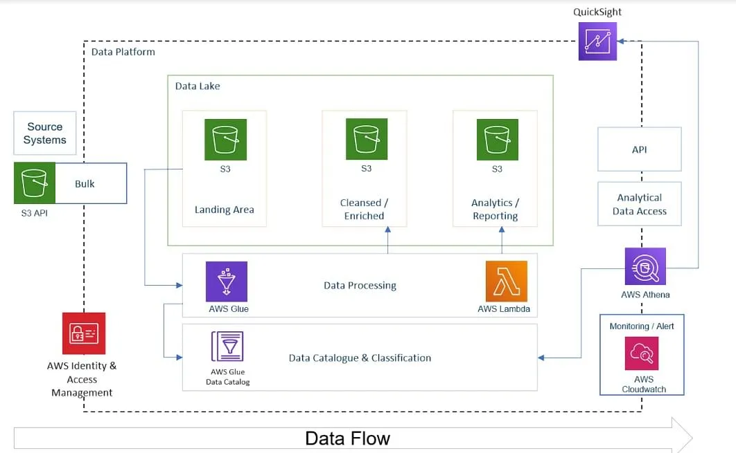
Planned workflow of project
Credit

Slide 10






Tools and technologies
YouTube Data API v3
AWS Lambda
Redshift
AWS S3
Amazon Athena
AWS CloudWatch
Amazon QuickSight
AWS CloudWatch

Slide 11

Any Questions
?

Slide 12
Thank
you!

